Slide 1
Bauska Bypass PPP Project
Open day II
Riga
NOVEMBER, 2025
The information in this file may change due to factors beyond LSR's control

Slide 2
Contents
Project Description | 3
Technical Readiness | 7
Indicative Timeline | 9
Indicative Awarding Process | 10
Qualification Phase | 12
Awarding Phase | 18
Negotiations Phase | 19
Structure of the PPP Contract | 20
Q&A

Slide 3
Project Description 1/4
Type of the PPP contract | DBFM (Design – Build – Finance – Maintain)
Type of the Procurement | Competitive procedure with negotiation
Duration of the PPP Contract | 23.5 years: < 3.5 years for design and construction + 20 years maintenance
Type of Payment | Availability payment (Commences as of availability date)
Public Partner | Ministry of Transport & Latvian State Roads, state Ltd.
Private Partner | The selection will occur during the competitive public procurement procedure with negotiations
Balance Sheet Treatment | Off the government balance sheet
Gross Availability Payment | EUR 13 165 00 - 14 536 300* excl. VAT/ per year**
*The amount in real prices (unindexed)
**Due to the impact and proximity of the Rail Baltica project, technical solutions may change, potentially affecting the project's Capex.

Slide 4
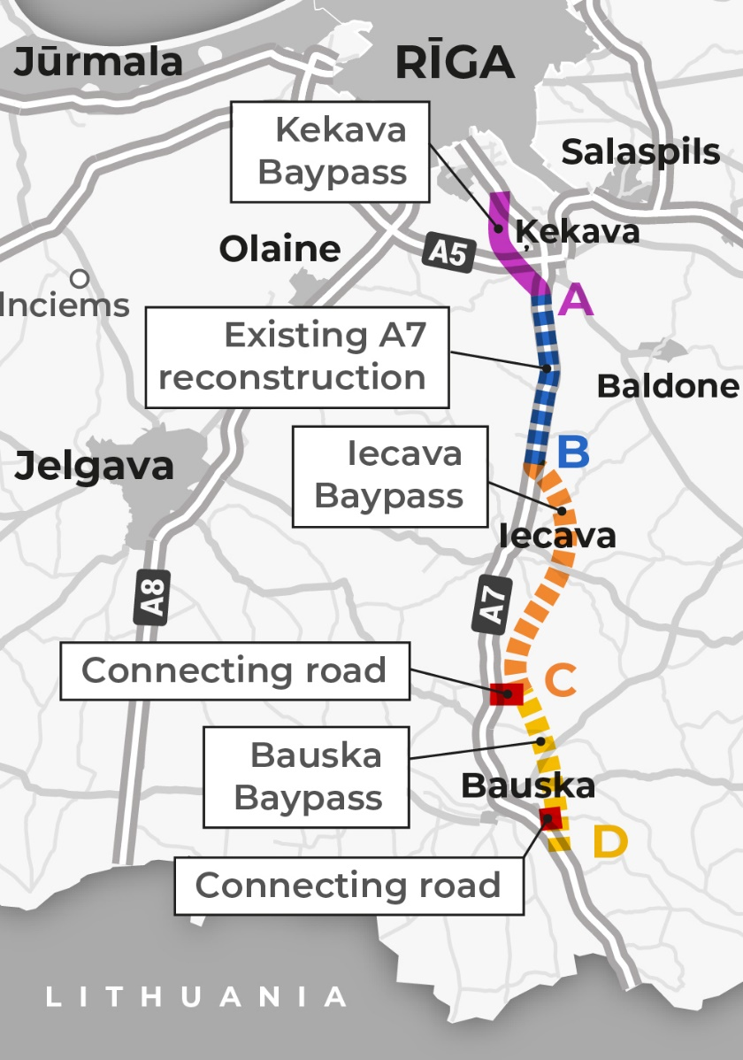
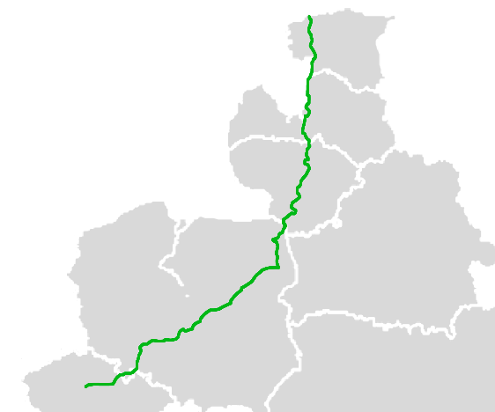
Project Description 2/4
National main road A7 Riga–Bauska–Lithuanian border (Grenctāle) part of:
  European transport network (TEN-T) North Sea-Baltic corridor;
  European route E67 or Via Baltica (from Tallinn to Warsaw).
International passenger and transit freight transport flow.
Military mobility between the Baltic States and the EU.
The existing A7 passing through the town of Bauska causes noise and air pollution, vibrations, and severely affects road safety and quality of life.

Slide 5
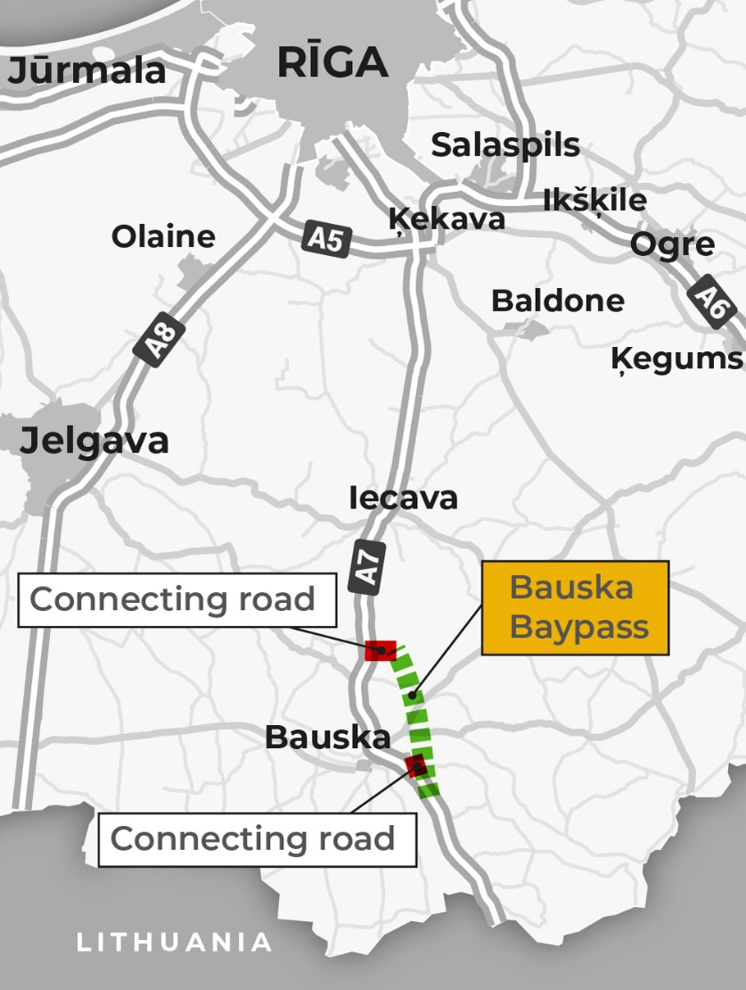
Project Description 3/4
BAUSKA BYPASS | 17.5 km
New road section Planned road cross-section NP 26 four-lane road | 14.25 km
Connecting road near Code Parish Planned road cross-section NP 10.5A two-lane road | 2.23 km
Connecting road near Bauska Town Planned road cross-section NP 10.5 two-lane road | 2.73 km
Total length: | 19.21 km

Slide 6

Project Description 4/4
STRUCTURE AND JUNCTIONS
2 grade-separated junctions
2 roundabouts to connect with the existing A7
1 bridge over the River Mēmele
1 grade-separated pedestrian/cyclist bridge

Slide 7
Technical Readiness 1/2
Technical Feasibility Study
The original Technical Feasibility Study for the E67 Via Baltica section A4 (Saulkalne)–Bauska (Ārce) was completed in 2009.
Environmental Impact Assessment (EIA)
Conducted in 2009 for the construction of the main national road E67 section A4 (Saulkalne)–Bauska (Ārce) and approved in accordance with the Law on Environmental Impact Assessment. The EIA remains valid and does not have an expiry date.
Updated Technical Feasibility Study
The update of the Technical Feasibility Study was completed in August 2025.
This update also includes revisions to address environmental considerations for the Project.

Slide 8
Technical Readiness 2/2
Land acquisition process started in 2024 and shall be completed by Financial Close.
The construction permit shall be obtained initially by LSR and transferred to the private partner after signing the PPP contract;
Part of the technical requirements were received by LSR during the update of the technical feasibility study; the remaining technical requirements shall be the responsibility of the private partner, including their subsequent updates;
The level of detail of the technical design in the initial bid, BAFO, first interim design, and approved design shall vary in accordance with the principle of increasing the level of detail compared to the initial bid.
The tenderers will be responsible for obtaining topographic and geotechnical studies. Topographic data and results of the geological study are also partially available in the updated technical feasibility study and in the 2009 technical feasibility study; consequently, this data must be updated and detailed. Permissions will be granted to bidders to perform drilling works on state-owned land upon request;
Once the PPP contract is signed, the design and construction process shall be administrated via the Construction Information System (in Latvian, "BIS").

Slide 9
Indicative Timeline
Feb 2026
Submission of qualification
documents
Apr 2027
Invitation to submit BAFO
2030/2031
Availability Date
Nov 2027
Evaluation of BAFOs
Announcement of the Tender results
Oct 2026
Submission of the initial bid
6 weeks
7 months
3 months
3 months
6 weeks
3 months
4 months
6 months
Mar 2026
Evaluation of qualification
proposals
Invitation to submit initial bids
Aug 2027
Submission of the
BAFO
Jan 2026
Qualification Phase
announced
May 2028
Financial and commercial close, completion of DD
Feb 2027
Invitations to Negotiations

Slide 10

Indicative Awarding Process 1/2
Announcement of Tender
Qualifiaction Phase
Financial
Professional certificates PPP experience
Experts
A bidder with subcontractors;
Financially stable consortium;
International experience (DBFM, DBFO);
Optimized project costs – local execution;
2 reference PPP projects.
Submission of Qualification documents
Compliance
1st quote valuation
No limits regarding number of candidates

Slide 11
Indicative Awarding Process 2/2
Announcement of Awarding phase
Submission of 1st quote
Principles:
  Technical documentation, but not at the level of the first interim design (different level of detail for initial bid and BAFO);
  Bid improvement process via negotiations;
  Price is fixed at BAFO;
  Final project design based on the technical design submitted.
Initial offer:
  Technical design;
  Financial model;
  Bid bond.
Negotiations:
  Technical design;
  Financial model;
  PPP contract (open parts).
4. BAFO:
Improved technical design;
Improved financial model
100%
Availability date 10%
Financial 90%
(Indexed and non-indexed)
Awarding Phase
1st quote valuation
Max 3 candidates
Back-up list
Negotiations
BAFO requirements
Submission of BAFO quote
Availability date 10 %
BAFO valuation
100%
Financial 90 %
(Indexed and non-indexed)
Decision of the winner & PPP contract finalization
Contract, Direct Agreement and Financial close

Slide 12
Qualification Phase
All interested parties submit qualification documents
Documentation outlining the main PPP contract terms, together with an appendix laying out the technical requirements for design, construction, maintenance and handback of the bypass
To get qualified, candidate shall meet each of the minimum financial, technical and expert criteria. If any of the minimum requirements is not met, the candidate will be disqualified
Qualification criteria for experts are not covered by this presentation.
All Candidates who pass the selection criteria are invited to submit initial offers.
Objective of the qualification | Indicators
Economic and financial strength | Contributable equity capital, turnover, equity capital and financial strengths (ratios)
Experience in executing similar works (critical tasks) | Reference projects (designing, construction, maintenance)
Experience in executing PPP projects | 2 reference projects

Slide 13
Qualification Phase/Financial Criteria
Criteria | Description | Comments
Contribution to equity capital | Ability to contribute a minimum of 15 million EUR* Proof of the ability to contribute must be shown through a consolidated annual report | Minimum requirement
Turnover | Average consolidated turnover in construction of at least 100million EUR* for the last three financial years. | Minimum requirement
Equity Capital | Equity capital of at least 20million EUR* in the construction sector at the end of the last full financial year. | Minimum requirement
Financial requirements | During each of three last full financial years in the construction the candidate has achieved liquidity ratio of no less than 1 and equity ratio of no less than 20 %. | Minimum requirement
* These figures are shown excluding VAT

Slide 14
Qualification Phase/Technical Criteria 1/2
Criteria | Description | Comments
Construction | Max 5 reference projects complying with the following requirements: The total investment shall exceed 100 million EUR*, and none of the reference projects shall have a total investment below 5 million EUR* At least one reference project shall exceed a total investment of 30 million EUR* Projects dating no more than 10 (ten) years back Reference projects can be submitted by no more than 3 (three) construction companies | Minimum requirement
Design | Max 5 reference projects complying with the following requirements: The total investment shall exceed 100 million EUR*, and at least one reference project shall exceed the total investment of 30 million EUR* Projects dating no more than 10 (ten) years back Reference projects can be submitted by no more than 3 (three) designing companies. None of the reference projects shall have a total investment below 5 million EUR* | Minimum requirement
Projects must be implemented in a member state of the EU, EEA, the UK or Switzerland.
* These figures are shown excluding VAT

Slide 15
Qualification Phase/Technical Criteria 2/2
Criteria | Description | Comments
Maintenance | Max 5 reference projects/ contracts complying with the following requirements: At least one of the reference projects must be accomplished on a road with a traffic intensity of at least 5000 cars per day The total contract price shall exceed 30 million EUR* Projects dating no more than 10 (ten) years back | Minimum requirement
PPP | 2 reference projects, dating no more than 10 years back, complying with the following requirements: Demonstrate experience in the public–private partnership under the Design-Build-Finance-Maintain model (DBFM) or Design-Build-Finance-Operate model (DBFO), any of which has been based on the availability-based payment mechanism At least one of the reference projects shall be a road infrastructure PPP, while the other reference project shall be any transport infrastructure PPP (for instance, roads, streets, road tunnels, bridges, overpasses, viaducts, railways, trams and any rail tracks, airfields, runways, airstrips, taxiways, aprons, aircraft parking areas). Both reference projects must be completed, that is, financial close has taken place prior to the date of submission of the reference. | Minimum requirement
Projects must be implemented in a member state of the EU, EEA, the UK or Switzerland.
* These figures are shown excluding VAT

Slide 16
Qualification Phase/Experts
The candidate must demonstrate the availability of all of the following experts:
Design Manager
Bridge Designer
Road Designer
Site Manager
Road Site Manager
Bridge Site Manager

Slide 17
Financial Model Requirements
Financial model shall comply with model requirements
(no template will be provided).
For the initial bid, several key assumptions shall be provided for use and will be replaced by actual assumptions when providing BAFO.
Supporting documentation substantiating calculations, assumptions, and descriptions shall be comprehensive and detailed enough for any competent finance analyst to evaluate the logic and correctness of the assumptions used, without requiring any additional information.
Financial Model shall be prepared for the entire term of the PPP Agreement.

Slide 18
Awarding Phase
Award procurement documentation shall be distributed to tenderers invited to submit initial offers. The draft PPP contract is a part of the award procurement documentation.
A bid bond must be submitted along with the initial offer.
Up to three tenderers with the highest initial offer scores shall be invited to negotiate.
Negotiations primarily relate to the technical part of the initial offer and the open parts of the PPP Contract. The financial offer can be only reduced when preparing the BAFO and increased only if any additional item or work is requested during negotiations.
At the end of negotiations, all negotiating tenderers shall receive individual written instructions on how to improve their initial offer, so that it can be submitted for BAFO.
Following the valuation of the BAFO, the tenderer awarded the right to enter into the PPP contract shall be announced. Prior to signing the PPP contract, the financiers shall perform their due diligence (financial, tax, legal, and technical), and a Direct Agreement shall be negotiated with the financiers. Following the granting of financing, the PPP contract shall be signed on the same date as the Financial Close, the Contract Date, the Commencement Date, and the signing of the Direct Agreement. If financiers do not grant financing, the second-highest-ranked tenderer shall be invited to undergo the due diligence and enter into the PPP contract.
In case the second-highest-ranked tenderer is not be granted the financing, the procurement procedure shall be terminated without awarding the PPP contract.

Slide 19
Negotiations Phase
The goal during this phase is to establish clear communication channels with bidders, ensure alignment of technical offers with the project's objectives, and discuss the open parts of the PPP contract. Discussions will focus on refining the initial bids from no more than the top three bidders.
Negotiations will mainly focus on technical, financial, and legal issues raised by the bidder. In parallel, LSR shall retain the right to propose its own topics for negotiation.
The primary focus will be on ensuring compliance with project requirements and standards.
The sections of the PPP agreement open for discussion will be clearly identified.

Slide 20
Structure of the PPP Contract
Main text of the Contract
Annexes:
Definitions
Payment Mechanism
Financial Model
Technical Requirements for Design, Construction, Maintenance, and Handback
Compensation in Case of Early Termination
Consultation Committee
Approved Subcontractors
Other annexes as required

Slide 21
Structure of the Main Text of the PPP Contract
Content of the Contract
1. Contractual Rules on interpretation, application, adjudication and enforcement
2. Subject Matter
3. Payments in General
4. Availability Payment
5. Invoicing
6. Term
7. Amendments to the Contract
8. Changes in Works
9. Period up to the Financial Close
10. Design
11. Construction Area
12. Construction Works
13. Availability Certificate
14. Completion Certificate
15. Availability Phase
16. Hand Back
17. Contractual Provisions for the Whole Validity Term
18. Liability and Indemnities
19. Supervening Events
20. Early termination
21. Intervention Rights
22. Notices
23. Concluding Provisions

Slide 22
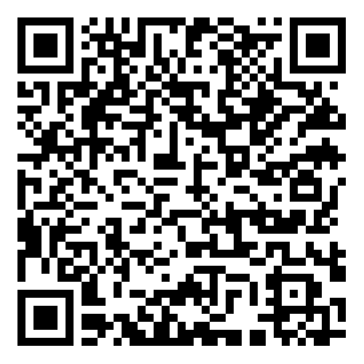
www.lvceli.lv
bauskabypass@LVCELI.LV
Comments & Suggestions on Bauska Bypass PPP Project.

